Slide 1
Math analysis
Day 16

Slide 2
Objective
To code a centered version of your first and last name in Bricklayer-Lite, with a background color, and a presentation to describe your thought process.

Slide 3
Name Project
You must code two names (first and last preferably), one stacked on top of the other one
The names must be centered on each other
You are to use at least “4” colors to distinguish names from backgrounds
Be prepared to talk us through your code, your thought process, and be able to answer questions about what it does…
You can use functions from Level 2 if you would like…

Slide 4
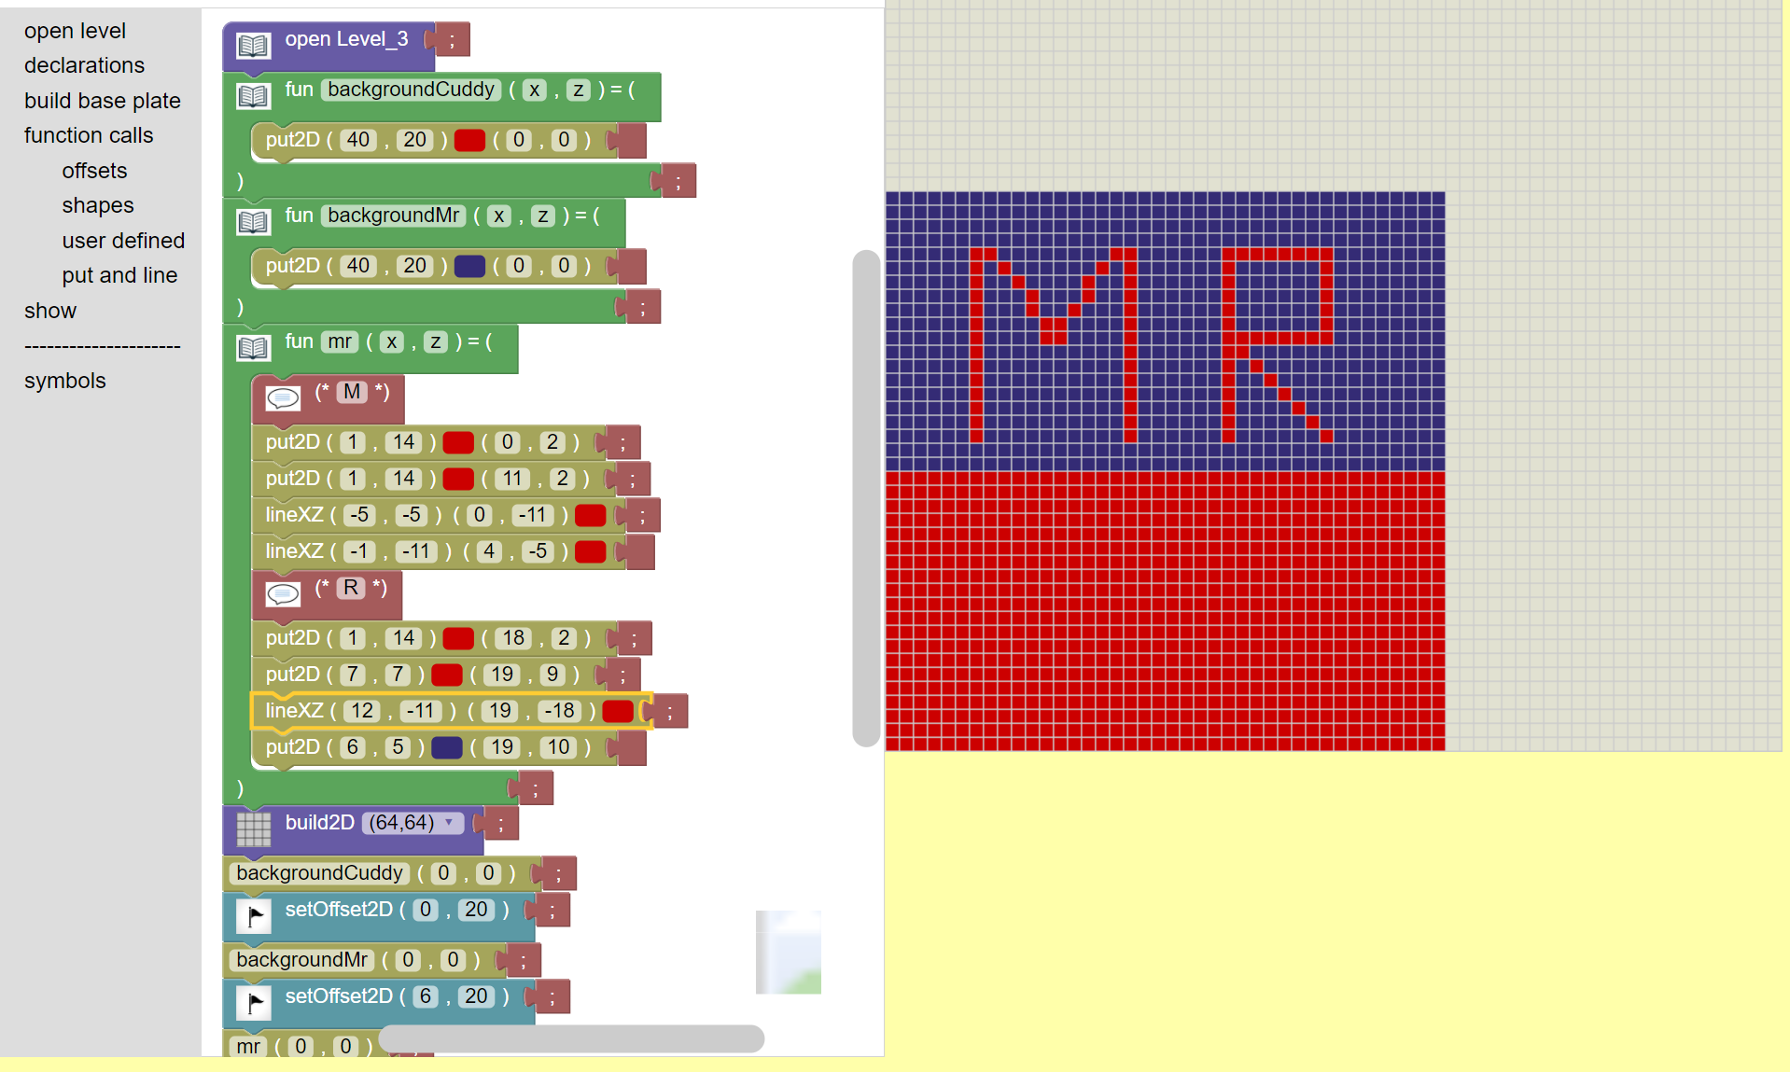
Example to get you started…

Slide 5
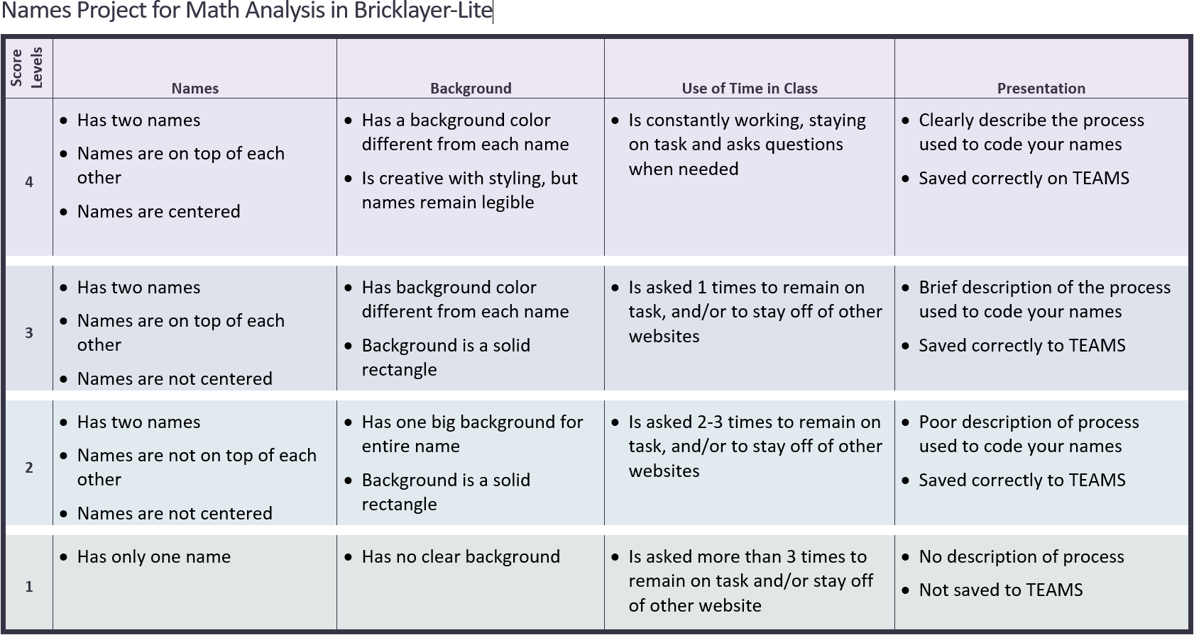

Slide 6
Presentations
Be able to easily maneuver within your code to answer questions about what each piece does
Describe your thought process, and how you came to your creation

Slide 7
Review Saving in Bricklayer Lite to Teams
Change “Filename” make sure it ends with .xml
Click Download XML
Open up Teams
Open the appropriate folder: ______________________
Click “upload” and select your recently downloaded file
Save
*Move the file to your Own Drive from your Downloads folder

